Slide 1
Blastpoint Loan Approval Project
Jared Andrews

Slide 2
Project Context
Goal: Develop an ML model to automate the loan approval process for new applicants
Provided Data
Application data for every loan approved between 10/6/2010 and 4/17/2011
Binary indicator signifying loan performance (i.e., ‘Good’ or ‘Bad’)
High-level Modeling Approach
Binary classification task
Training:
Input features: Provided application data
Target feature: Loan performance indicator
Note: Loan performance will serve as a proxy for an approval feature (further discussed in limitations slide)
Online Prediction:
Output: Binary output indicating if a specific loan should or shouldn’t be approved

Slide 3
Model Performance Metrics
Assumption: absolute accuracy is not the primary performance metric
Given imbalanced training data, accuracy can be potentially maximized by always predicting the majority label (given scale of imbalance)
Consider F1-score/AUC-score evaluation metrics
Assumption: Better to miss approving a good loan than approving a bad loan
Minimize false positives
Consider recall evaluation metric
The proportion of all bad loans correctly identified
Action: Lower threshold which converts projected probability into class label
Can be individually catered based on level or risk a bank is willing to take on
Evaluation Metrics:
Accuracy, F1-score, AUC-score, recall

Slide 4
Data
Volume
650 samples, 33 features
Features
Customer Specific Information
General: Birth date, owns or rents residence, address zip code, email, etc.
Duration/Frequency: Residence duration, bank account duration, etc.
Credit History: Link2Credit score, FICO scores
Loan Specific Information:
Amount requested, payment frequency, loan duration, application submit date, etc.
Notes/Limitations:
Small sample size
No data dictionary provided
No macro-economic factors
One loan application per customer (no repeat customers)
Intended since goal is to identify if a new applicant should be given a loan

Slide 5
Initial Preprocessing
Handling Null Values
other_phone_type: 291 nulls → drop feature
payment_amount_approved: 22 nulls → data imputation
how_use_money: 2 nulls → drop null rows
bank_account_duration: 1 null → drop null row
Handling Boolean Values
Encode T/F, Y/N as 1/0
Features: residence_rent_or_own, bank_account_direct_deposit, payment_ach
Handling of Categorical Features Represented Numerically
Cast int as string
Features: address_zip, bank_routing_number
Credit Score Based Filtering
L2C and FICO credit scores range from 300-850
Remove anyone outside of predefined range – 30 samples

Slide 6
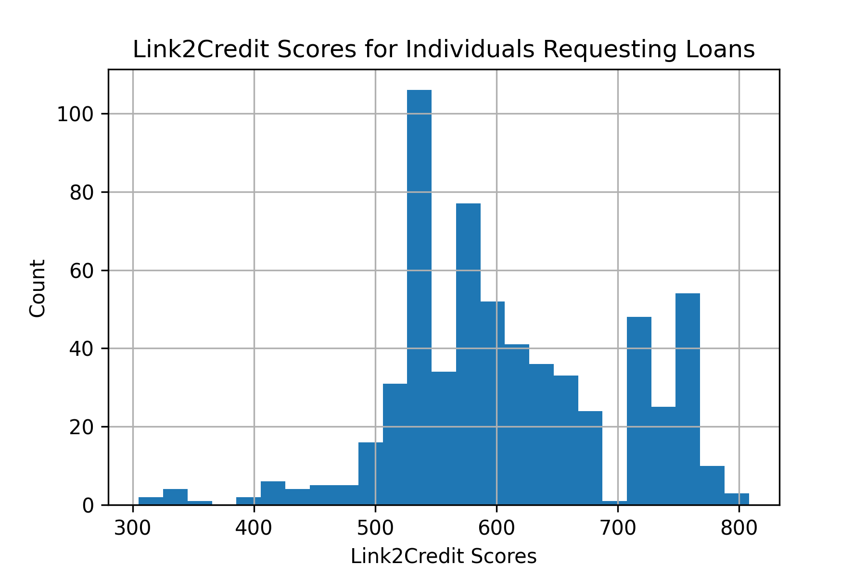
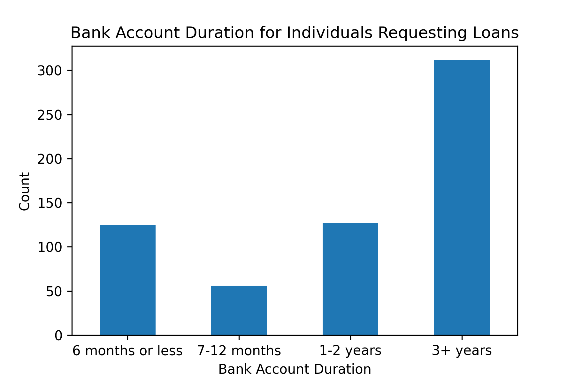
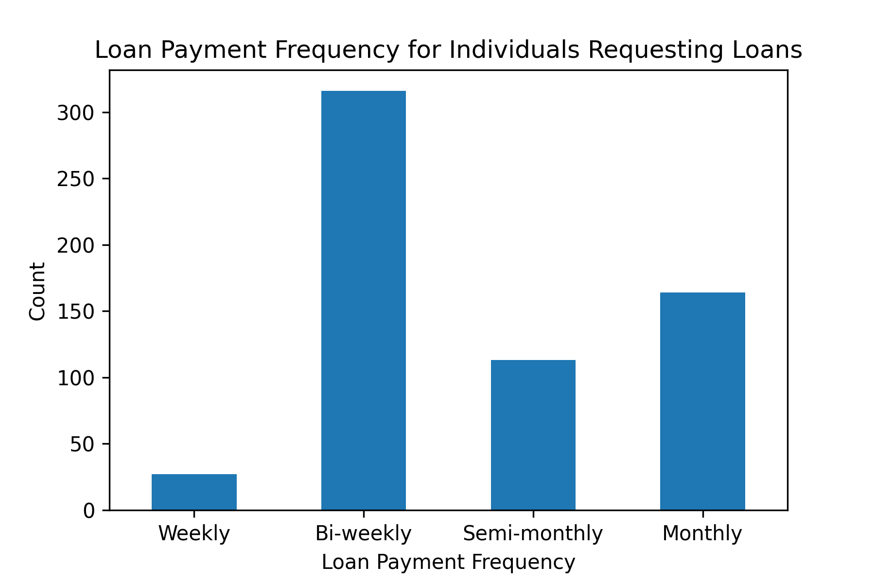
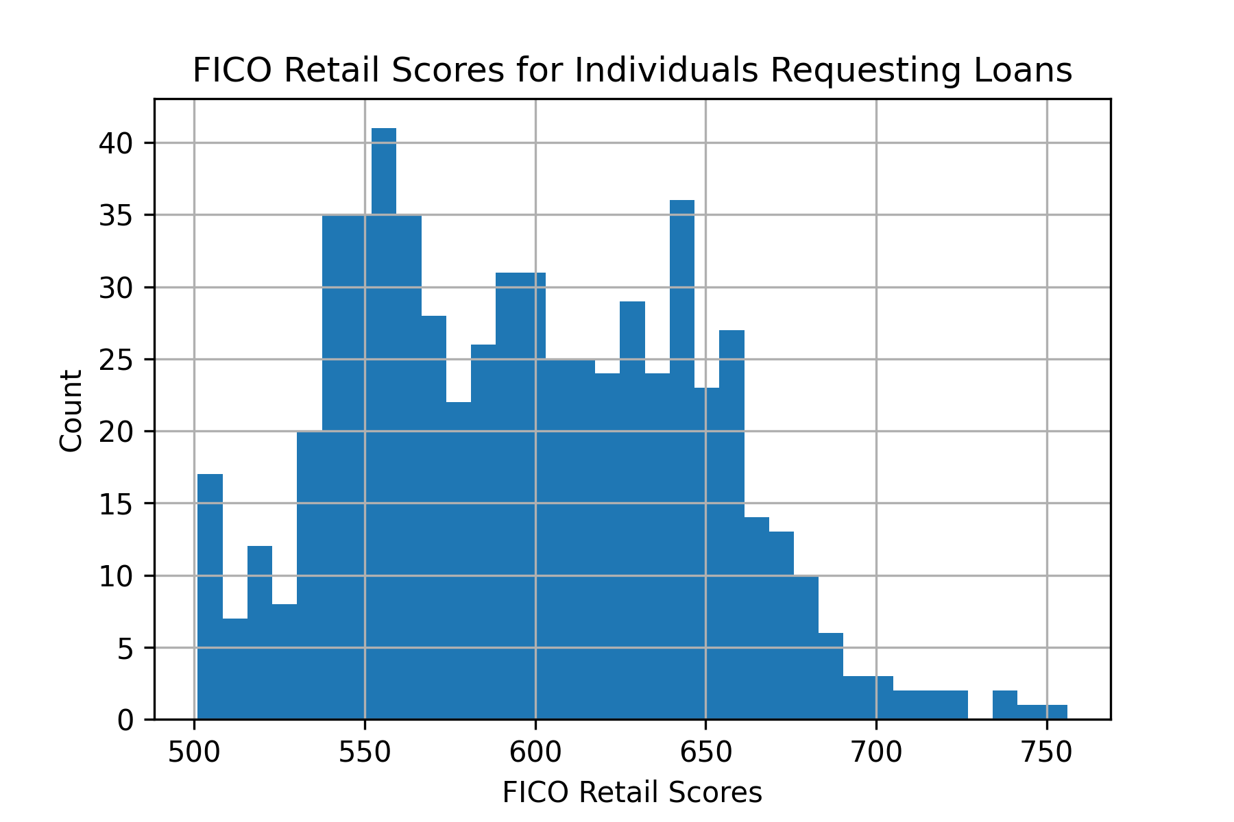
Exploratory Data Analysis- Univariate
Categorical Features → Value Counts, Histograms
Numeric Features → Descriptive Statistics, Histograms
Purpose: Get overall feel for features – possible values, variance, mean, mode
Gives intuition into feature engineering and feature selection
Target Feature Distribution
55.3% Bad
44.7% Good

Slide 7
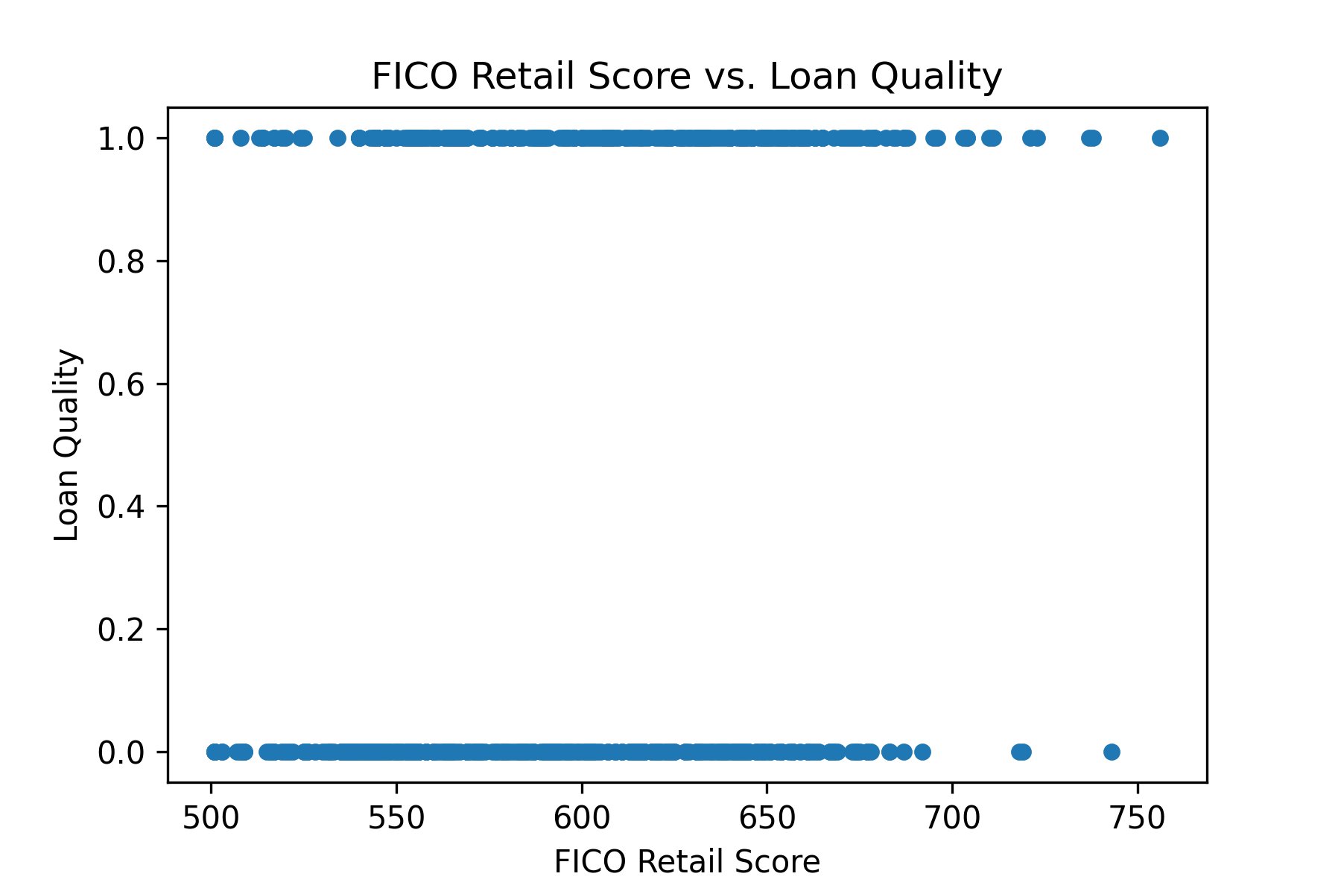
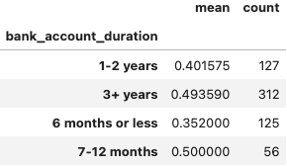
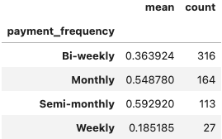
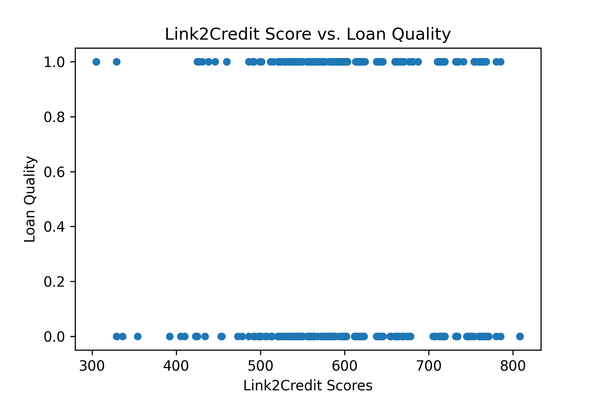
Exploratory Data Analysis- Multivariate
Categorical Features → Conditioned Value Counts, Conditioned VC Tables
Numeric Features → Conditioned Descriptive Statistics, Scatter plots
Purpose: See if feature may be a good predictor of loan quality
See if feature can separate good and bad loans

Slide 8
Exploratory Data Analysis- Feature Selection
Initial round of feature selection based on univariate/multivariate analysis
Remove features with zero/low variance of samples whose target feature has a large variance or that logically have zero predictive power
Removed Features
customer_id, status, email, home_phone_type, how_use_money, idLoan, payment_ach

Slide 9
Feature Engineering
Bin categorical features
Serves to reduce the dimensionality of one-hot encoded outputs and to remove low frequency values
Features:
Address zip: Keep first 2 digits of zip code; 193 -> 3 unique values
Bank routing number: Keep high frequency BRNs, move others into ‘default’ category; 130 -> 9 unique values
Duration features: Create category of ‘0-12 months’ (previous ‘months’ values were very low frequency)
Creation of new features
loanee_age: feature encoding loanee age
pays_rent: boolean feature indicating if the loanee pays rent
monthly_income_after_rent: feature capturing income level after paying rent
Base Feature Set
amount_requested, monthly_income_after_rent, residence_rent_or_own, bank_account_direct_deposit, loan_duration, num_payments, payment_amount, amount_approved, duration_approved, address_zip, bank_routing_number, email_duration, residence_duration, bank_account_duration, payment_frequency, raw_l2c_score, raw_FICO_telecom, raw_FICO_retail, raw_FICO_bank_card, raw_FICO_money, loanee_age, pays_rent

Slide 10
Model Training Preparation
Time-based train-test splits
Split samples sequentially based on application submit date
Train: 80% of data, Test: 20% of data
Training sample weights
Weigh more recent samples higher
Preprocessing
One-hot-encoding of categorical features
Min/Max scaling of numeric features

Slide 11
Training Process
Perform Feature Selection
For ensemble models, feature selection wasn’t performed
For non-ensemble models, used the SFS (Sequential Forward Selection) feature selection wrapper method
Perform Hyper-parameter Tuning
Utilize Optuna (automatic hyperparameter optimization software framework)
Used training set to produce time-based 5-fold cross-validation sets
HP configuration with the highest average F1-score across all folds was selected
Final Model Training
Train model using train set with the best feature set and best hyperparameters
Final Model Evaluation
Perform model evaluation on test set
Metrics: Accuracy, F1-Score, AUC Score, Recall
Model Explainability
Utilize native feature importance scores and SHAP values to gain insight into impact of features on the testing results

Slide 12
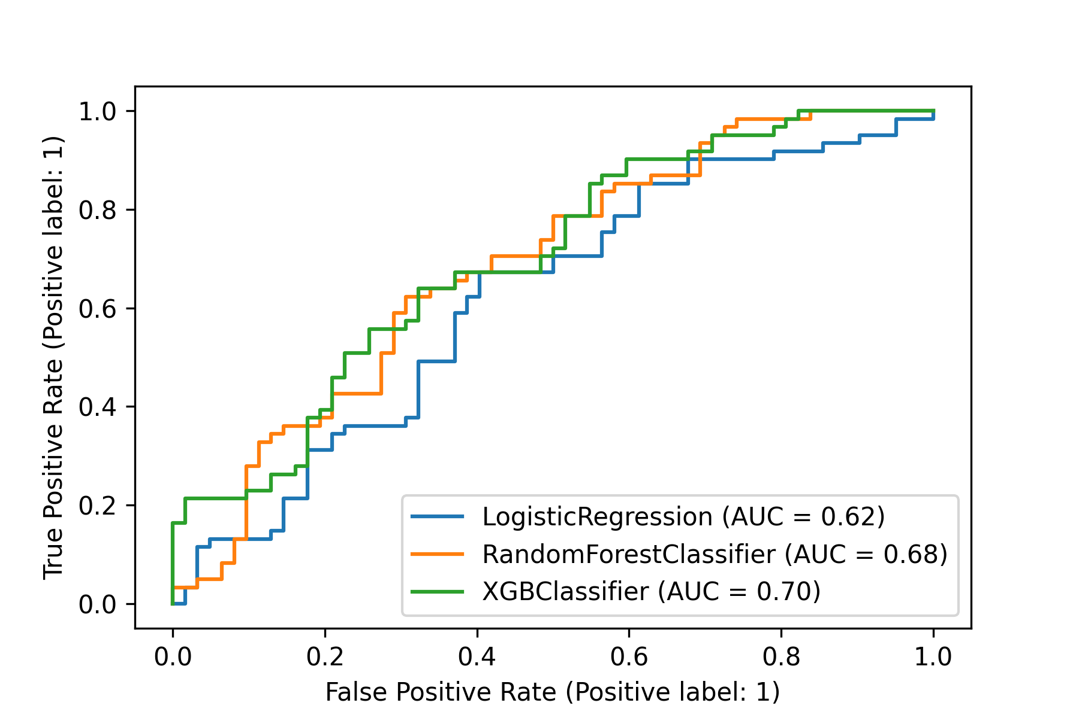
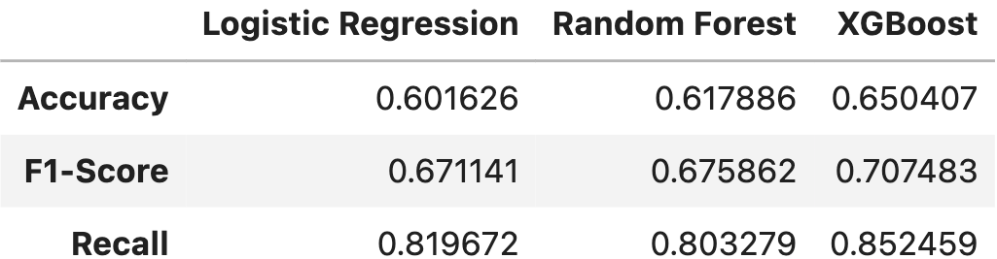
Model Experimentation
Train/Tested models listed below:
Logistic Regression
Random Forest
XGBoost
Test Results:

Slide 13
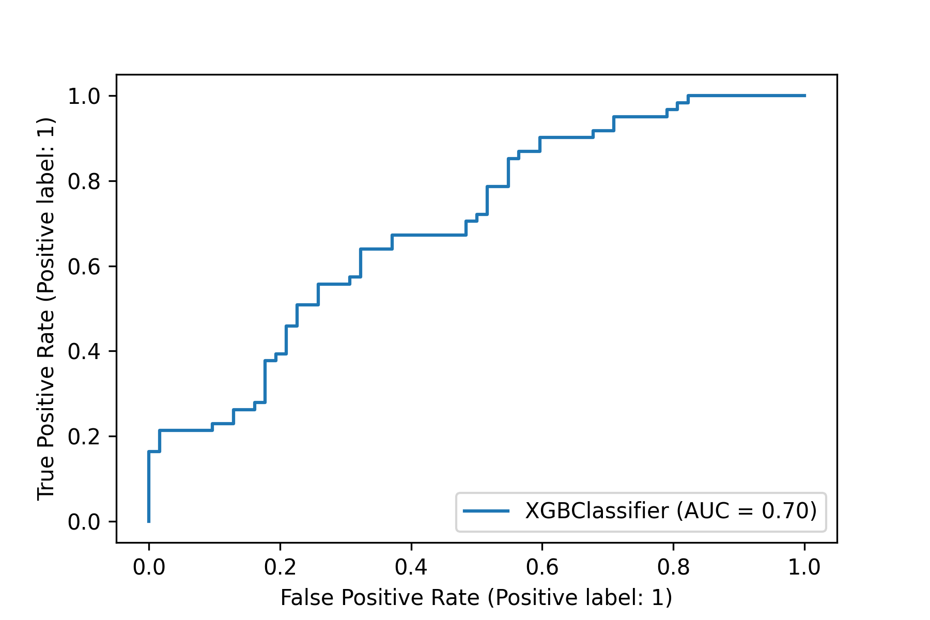
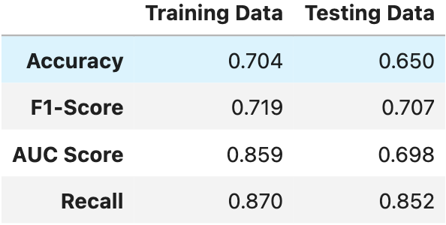
Final Model Analysis
Given highest accuracy, F1-score, recall and AUC-score, the XGBoost model would be chosen for production
Best HP configuration:
{booster: dart, lambda: 1.3195240310678462e-08, alpha: 2.2781983645806513e-06, n_estimators: 400, max_depth: 1, eta: 0.13090701285954356, gamma: 0.8560804526399561, grow_policy: depthwise, sample_type: uniform, normalize_type: forest, rate_drop: 8.428644473771179e-05, skip_drop: 1.1292626245131823e-05}
Train/Testing Results:

Slide 14
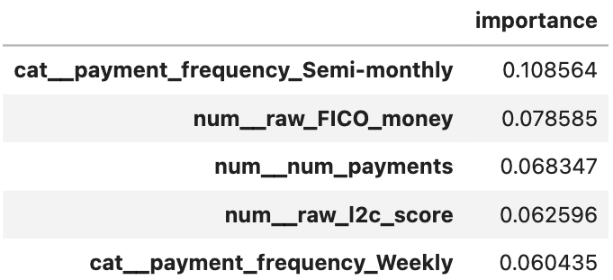
Model Explainability - Feature Importance
Calculated via XGBoost’s native feature importance score method
Utilizes “gain” which is “the improvement in accuracy brought by a feature to the branches it is on during training”
Observations:
Important Features: credit scores, payment frequencies, loanee age, (some) bank routing numbers, numeric payment info
Unimportant Features: address zip codes, residence durations, email durations, (some) bank routing numbers, renting related features

Slide 15
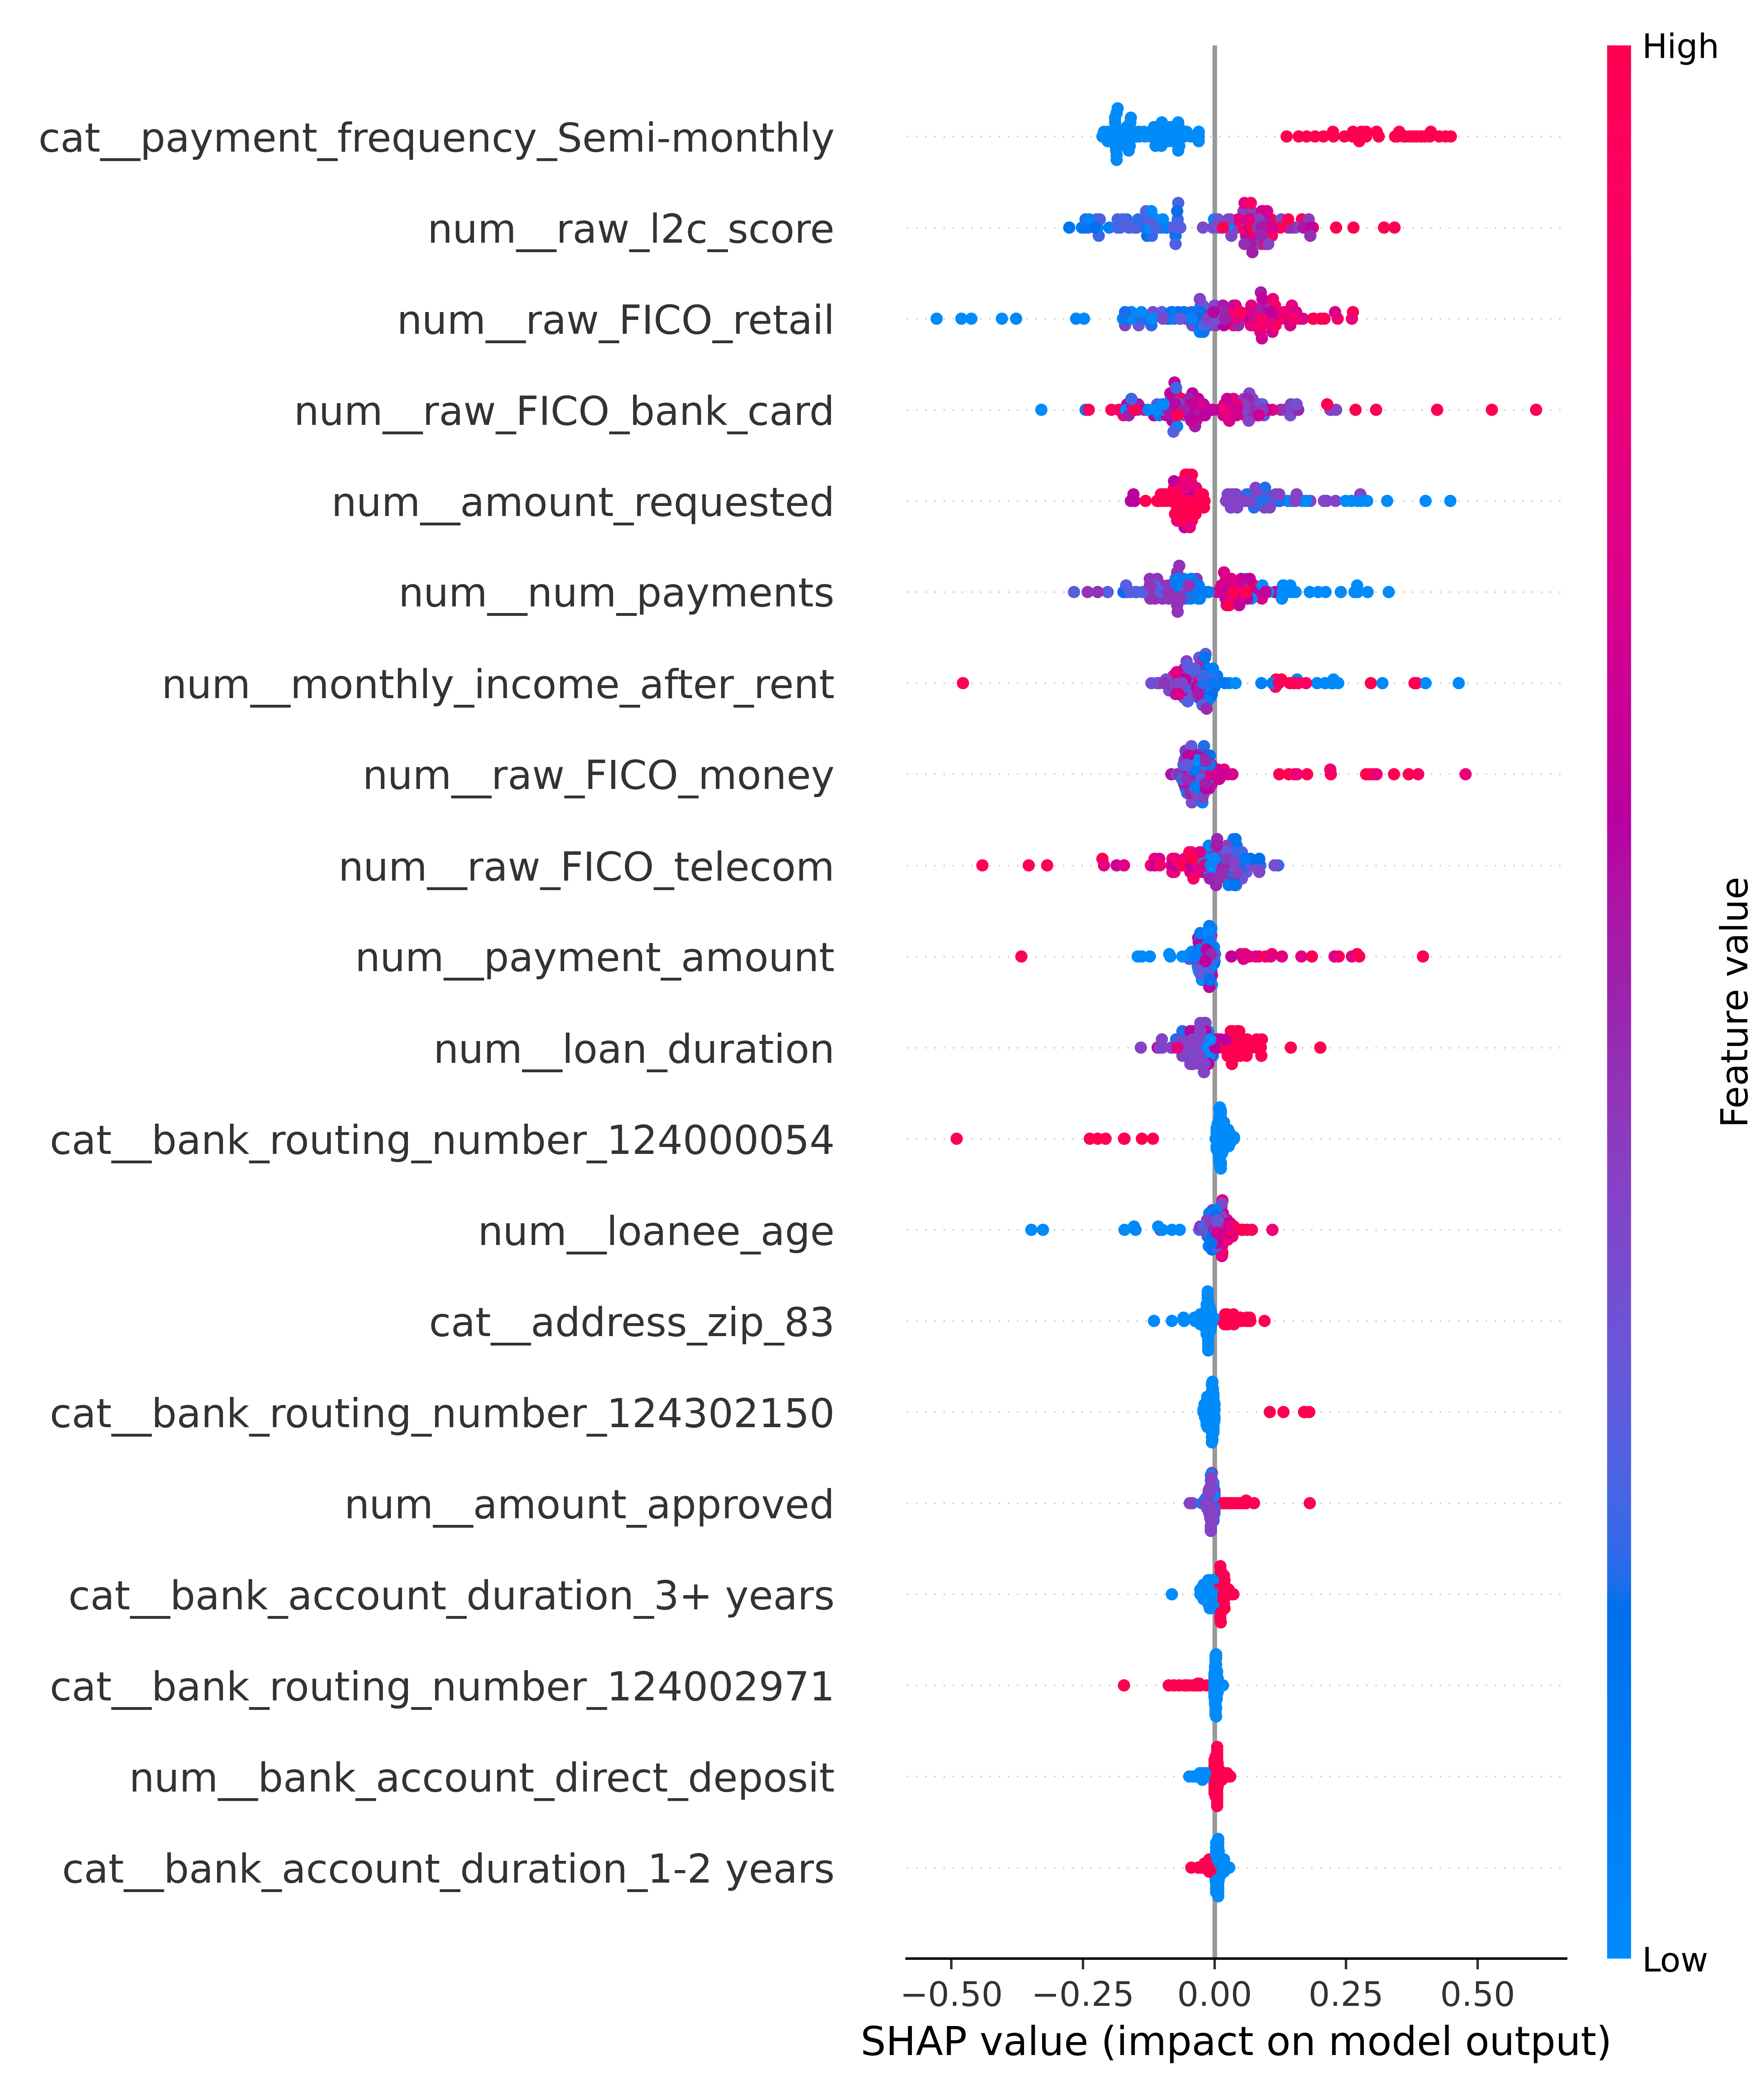
Model Explainability - SHAP Values
SHAP values encode the impact specific inputs features have on the resulting output
Based on testing data
Some observations
Higher credit scores led to higher output probabilities
Paying semi-monthly led to higher output probabilities
Higher requested amounts led to lower output probabilities
Older age led to higher output probabilities

Slide 16
Limitations/Shortcomings
Data limitations
Small sample size
No data dictionary provided
No macro-economic factors
Target feature proxy
Our training data’s target is whether an approved loan was good or bad
This serves as a proxy for our desired target, which is if a loan should be approved or not
Sample population
Only contained approved loans; an actual in-production model will encounter loans that will be denied
Personal knowledge
Minimal knowledge of the lending space
Minimal research into prior loan approval ML models

